Slide 1
Instacart A/B Test
Guohao Shen

Slide 2
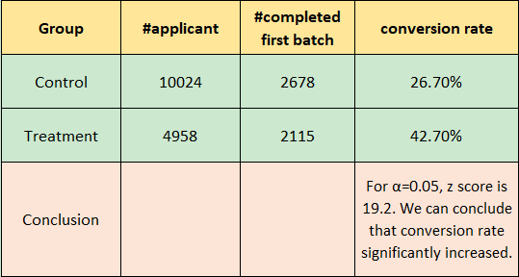
Q1: Evaluate A/B Test result
Notes:
To solve this problem, we can divide the number of ‘first_batch_completed_date’ by the number of ‘application_date’ for the control and treatment group separately. Based on the result shown above, we can conclude that initiating the background check earlier in the hiring process improved the conversion rates.
For α=0.05, z value is approximately 1.645. The z score we calculated is approximately 19.21, which is significantly greater than 1.645. We can then conclude that we fail to reject the null hypothesis.

Slide 3
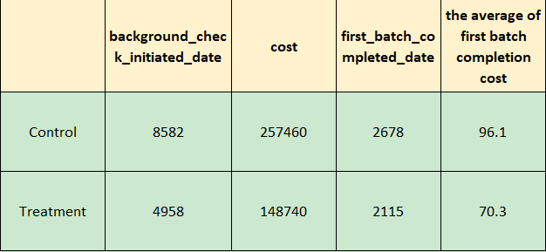
Q2: Is this change cost-effective?
Notes:
Yes, it is cost-effective.

Slide 4
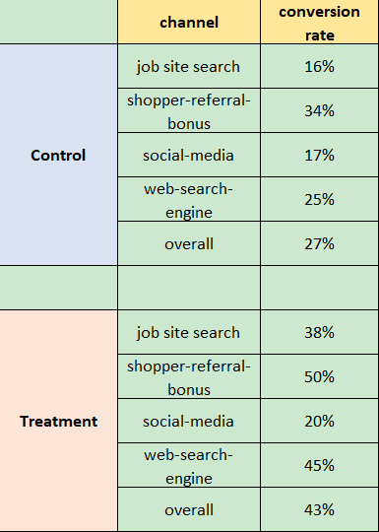
Q3: Observations?

